Slide 1
Nomad Bootcamp
26th Feb 2019

Slide 2
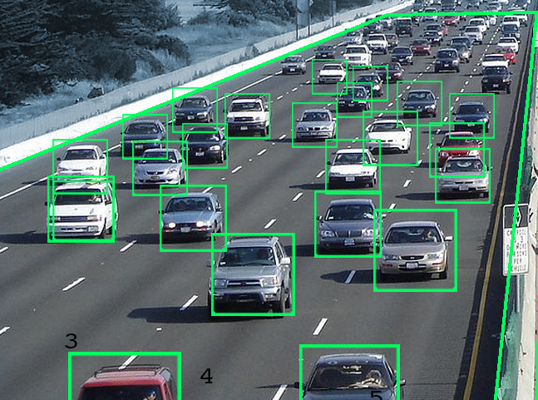

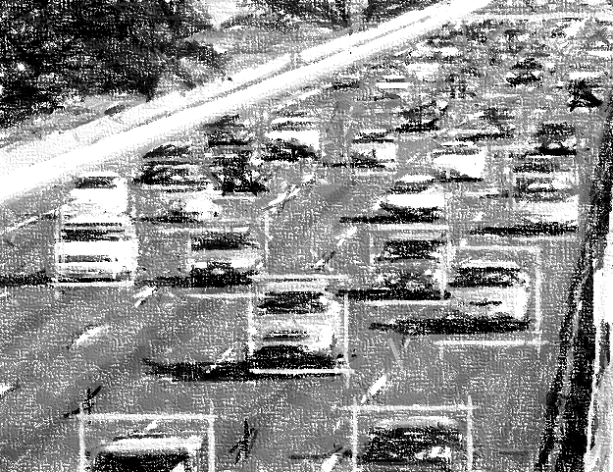
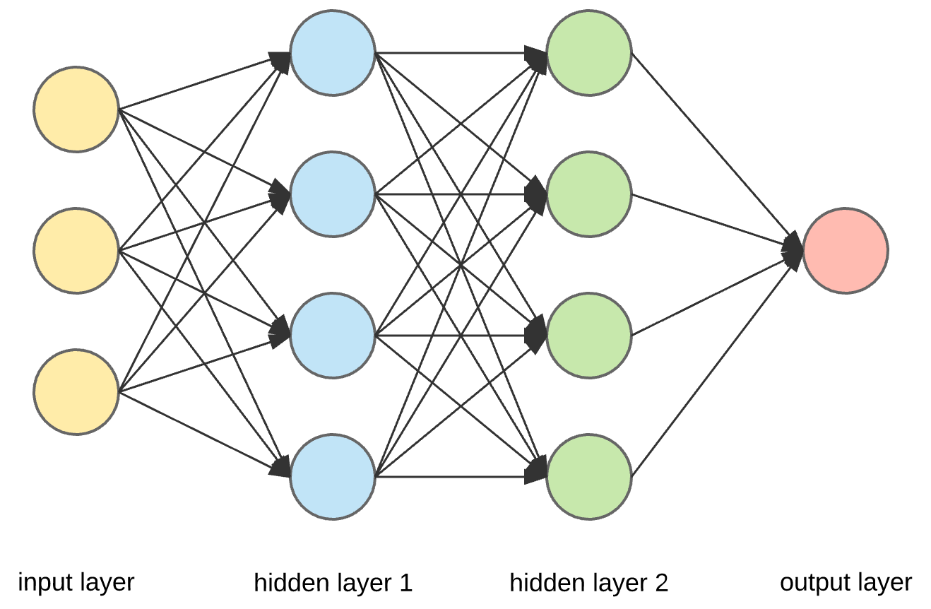



IoT Applications
Can be expressed as a sequential combination of independent operators
=
Traffic Surveillance
Video Capture
Pre-processing
Inference
=
Realtime Translation
Audio Capture
Resampling/Transform
Inference

Slide 3




IoT Application Deployments
Data shipped across the network, processed in the cloud
Monolithic Program
Edge
Gateway
Cloud

Slide 4
Heterogenous Infrastructure
Diverse device and network capabilities
Monolithic Program
Underutilized compute resources
Last Mile Network:
Low bandwidth
High latency
Edge
Gateway
Cloud
Notes:
This compute model does not take into account the infrastructure

Slide 5


Introducing Nomad
Partition and intelligently schedule pipelines across edge-cloud
Partitioned Program
Reduced network load
Edge
Gateway
Cloud
Notes:
This compute model does not take into account the infrastructure

Slide 6
Nomad Features
Partition pipelines easily
Automatic scheduling

Slide 7
Scheduling
Op0
Op1
Op2
Sensor Data
Network
Cost
Network
Cost
Result
Goal: Maximize pipeline throughput while satisfying the hard placement constraints and minimizing latency
Placement can be reduced to a minimization problem: Find the shortest walk of length k, from node s to node d.
Constraints: s: First node of the pipeline, d: Last node of the pipeline, k: Number of operators
Parameters: Worker CPU capacity, network throughput and latencies, Operator CPU requirements and message sizes
Solution: Recursive algorithm to exhaustively evaluate all possible placements and pick the minimal cost path
Compute Cost
Compute Cost
Compute Cost
Pipeline Operators
Node 0
Network Link
Node 1
0
1
Node 3
Node 2
2
Network Overview

Slide 8

Programming Model
import nomad def read_sensor(): import random return random.get_image() def preprocess(x): import cv2 new_image = cv2.resize(x) return new_image def run_nnet(x): import nnet_model nnet_model.run(x) def write_result(x): import redis redis.write("result", x) fns = [read_sensor, preprocess, run_nnet, write_result] start = "my_edge" end = "my_cloud" nomad.submit_pipeline(fns, start, end)
Video Capture
=
Preprocessing
Inference
Write Result

Slide 9
Demo

